Slide 1
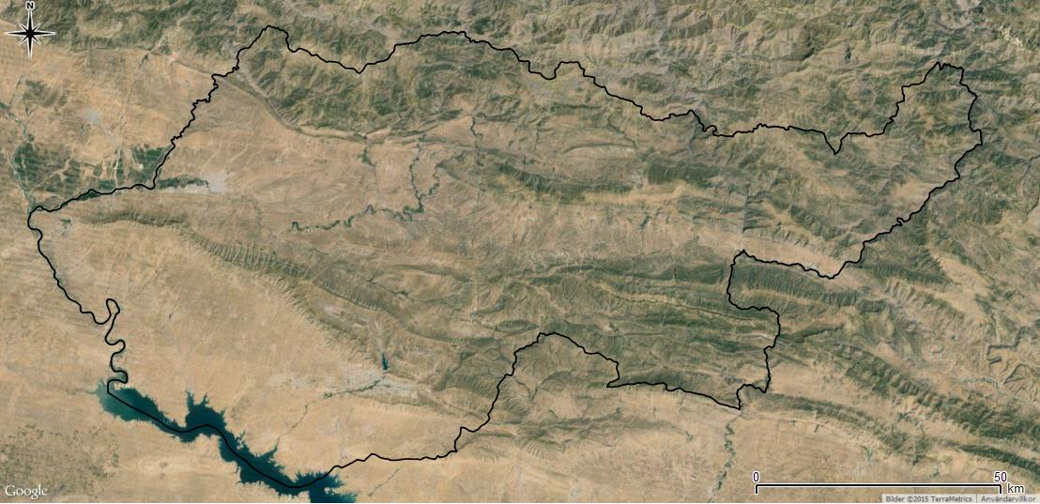
CROPLAND CLASSIFICATION USING OPTICAL AND RADAR DATA
TEAM: AKASH A (191EC102), NAVRATAN (191EC133) AND ROHAN J (191EC147)
MENTOR: DR. RAGHAVENDRA B S

Slide 2
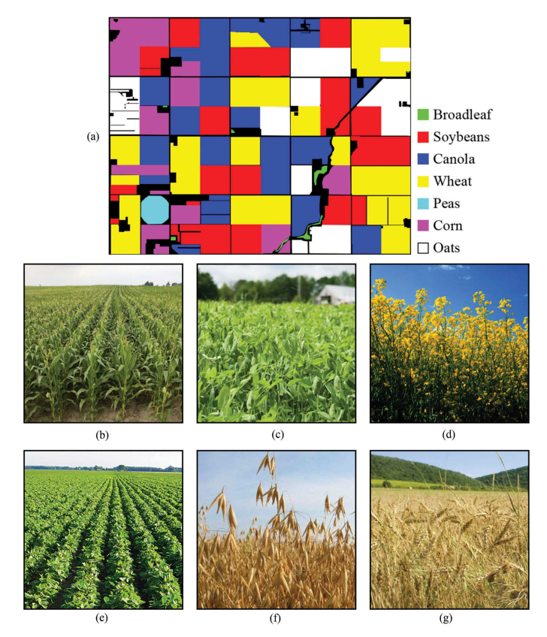
AN OVERVIEW
Motivation: Given radar and optical feature information, classify data of a single pixel into one of seven crop types
Possibility of use by NGOs and governments for agriculture planning and management
Efficient Classifier - Full image not needed; Only information about a single pixel is sufficient (Less Storage)
Dataset Available At: https://archive.ics.uci.edu/ml/datasets/Crop+mapping+using+fused+optical-radar+data+set

Slide 3
DESCRIPTION OF DATASET
Supervised Learning Problem - Data consists of 174 features - optical and radar taken on two different dates
Radar Features - Collected by sending radio waves in the L band and measuring characteristics of the reflected light
Optical Features - Spectral data collected by sending out waves in the RGB, Near Infrared (NIR) and RedEye Spectrum
Imbalanced Dataset - Seven kinds of crops; Number of samples for each crop was different

Slide 4
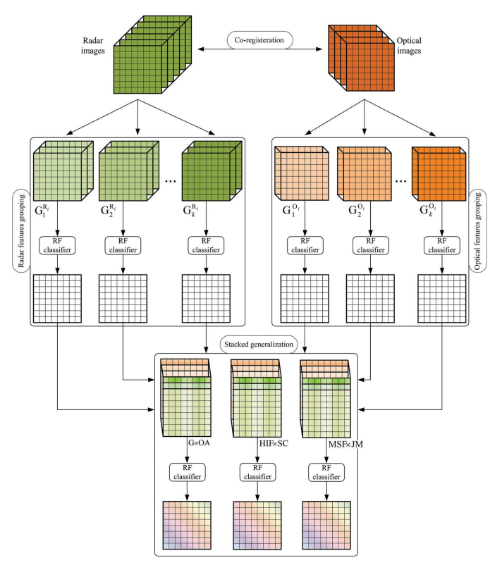
TECHNIQUES ADOPTED - BALANCED TRAINING
Features were divided into groups based on their similarity to optimize performance
A Random Forest Classifier was used to train data from each group and the accuracy was collected
Each group of data was then multiplied by the overall accuracy and then stacked together
Finally, training was done on modified data using another RF classifier

Slide 5
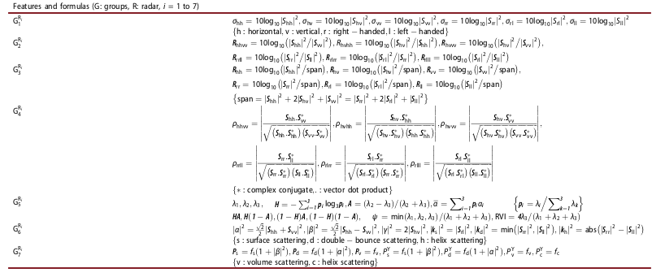
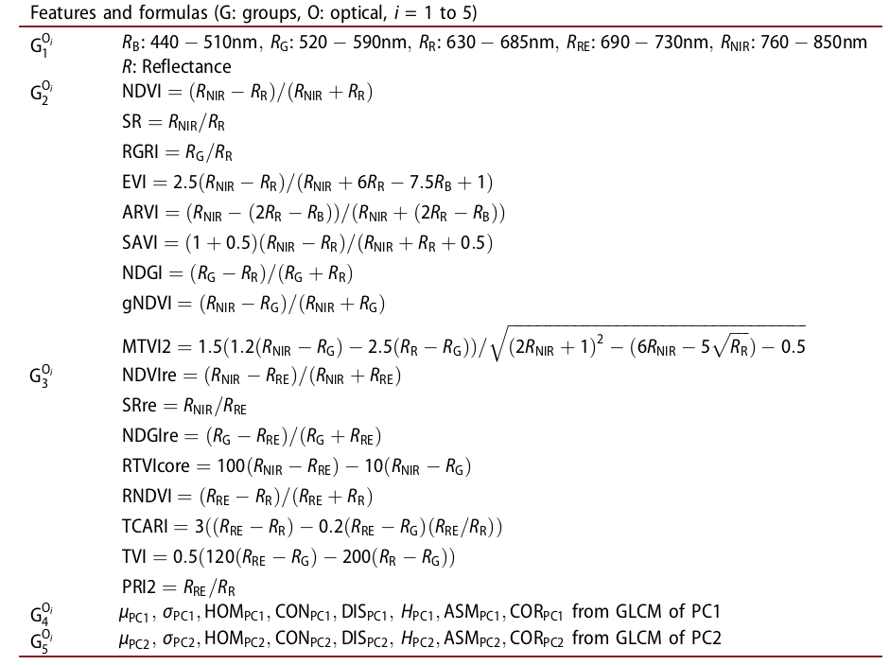
FEATURE GROUPS
RADAR FEATURES
OPTICAL FEATURES

Slide 6
IMPLEMENTATION
DATASET
RADAR FEATURE GROUPS ON DATE 1
RADAR FEATURE GROUPS ON DATE 2
OPTICAL FEATURE GROUPS ON DATE 1
OPTICAL FEATURE GROUPS ON DATE 2
RF CLASSIFIER AND OA STACKING
RF CLASSIFIER AND OA STACKING
RF CLASSIFIER AND OA STACKING
RF CLASSIFIER AND OA STACKING
OA STACKING AND CLASSIFIER
OA STACKING AND CLASSIFIER
OA STACKING AND CLASSIFIER

Slide 7
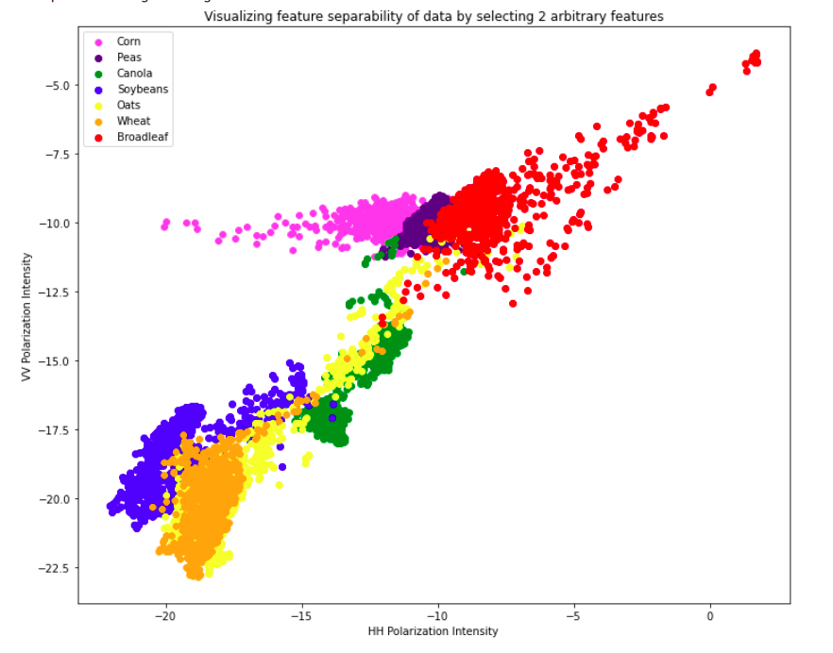
RESULTS OBTAINED EARLIER
STACKED FEATURES | OVERALL ACCURACY
RADAR FEATURES - DATE 1 | 60.33%
RADAR FEATURES - DATE 2 | 75.24%
RADAR FEATURES | 70.04%
OPTICAL FEATURES - DATE 1 | 66.67%
OPTICAL FEATURES - DATE 2 | 66.28%
OPTICAL FEATURES | 59.33%
RADAR & OPTICAL FEATURES | 64.03%

Slide 8
FINAL RESULTS AFTER IMPROVISATION
Earlier, predicted values were multiplied by overall accuracy and stacked for next stage - no improvement
Alternative was tried by multiplying the feature values themselves with overall accuracy - significant improvement
Final overall accuracy exceeded 90% - Exceeded performance obtained by research in given problem
Hyperparameters for RF classifier - No. of decision tree and number of features given to each decision tree
STACKED FEATURES | OVERALL ACCURACY
RADAR FEATURES - DATE 1 | 60.42%
RADAR FEATURES - DATE 2 | 75.22%
RADAR FEATURES | 86.87%
OPTICAL FEATURES - DATE 1 | 66.59%
OPTICAL FEATURES - DATE 2 | 65.86%
OPTICAL FEATURES | 78.60%
RADAR & OPTICAL FEATURES | 90.55%

Slide 9
IMBALANCED TRAINING - TECHNIQUES ADOPTED
Random Forest Classifier was tried out - Gave good results of about 96% for each of the groups itself but took too much time to converge. Hence, other techniques were explored
Neural Network architectures were thought of as an alternative since they can implement complex non-linear classifiers very optimally
Convolutional Networks could not be used since they have applications for images but here we are dealing with pixel data. Thus feedforward networks were resorted to with variation of hyperparameters
Two-thirds of the data was arbitrarily assigned as the training set and the remaining one-third as the test set. This leads to an imbalanced training since the original dataset itself is imbalanced.

Slide 10
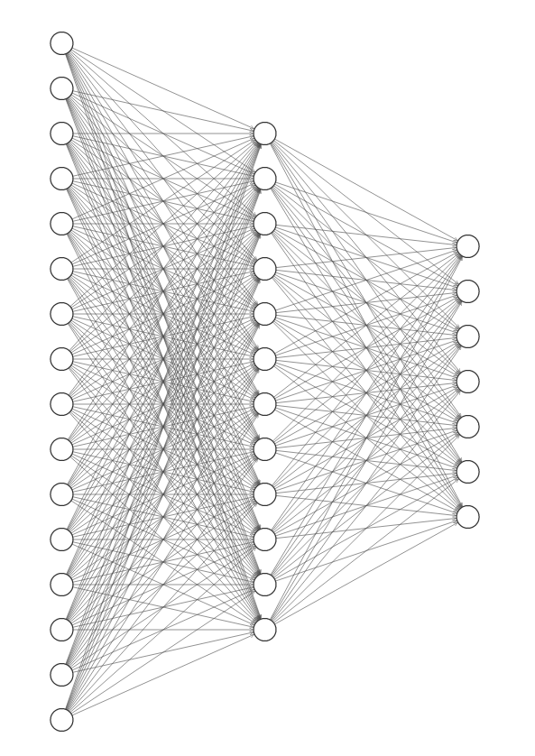
NEURAL NETWORK ARCHITECTURES
Three layers - Input Layer, Output Layer and a Hidden Layer
Input Layer has 174 neurons - equal to the number of input features
Output Layer has 7 neurons - Each represents the probability of the feature vector belonging to one of seven classes
Number of neurons in hidden layer is an important hyperparameter - geometric mean of input and output was considered here
Single Hidden Layer

Slide 11
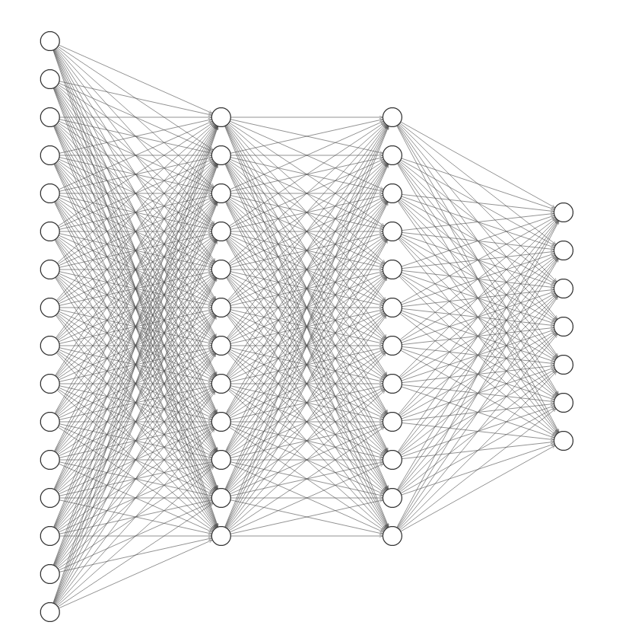
NEURAL NETWORK ARCHITECTURES - CONTD.
Number of hidden layers was chosen by method of trial and error - Hidden layers were added till accuracy no longer improved
Adam optimizer was used for training with Categorical Cross Entropy as error metric

Slide 12
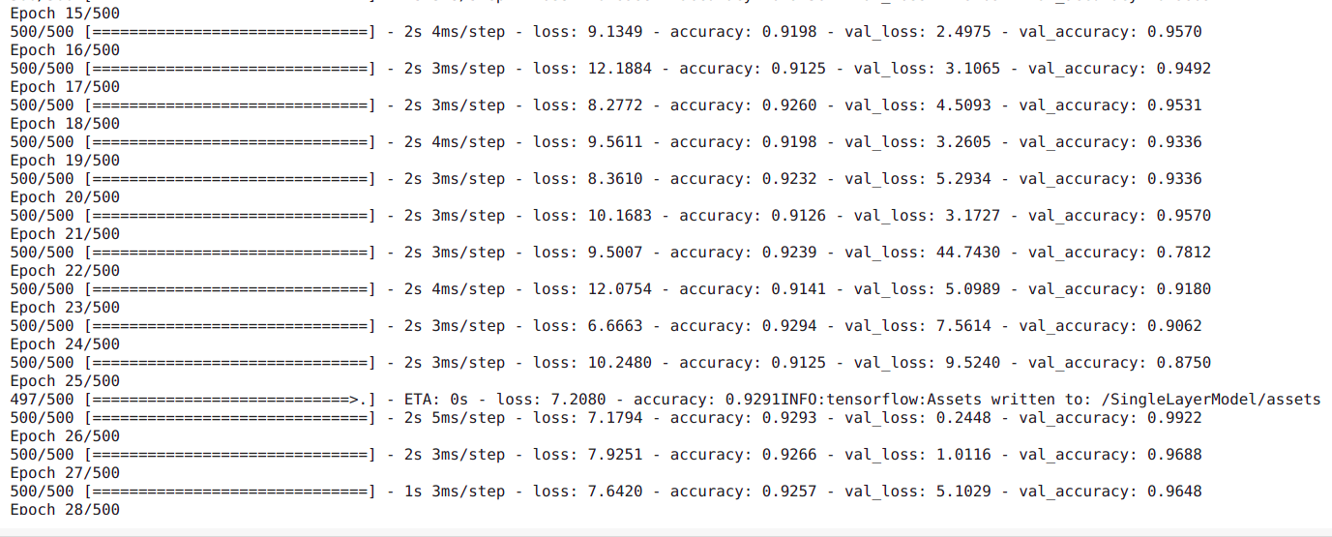
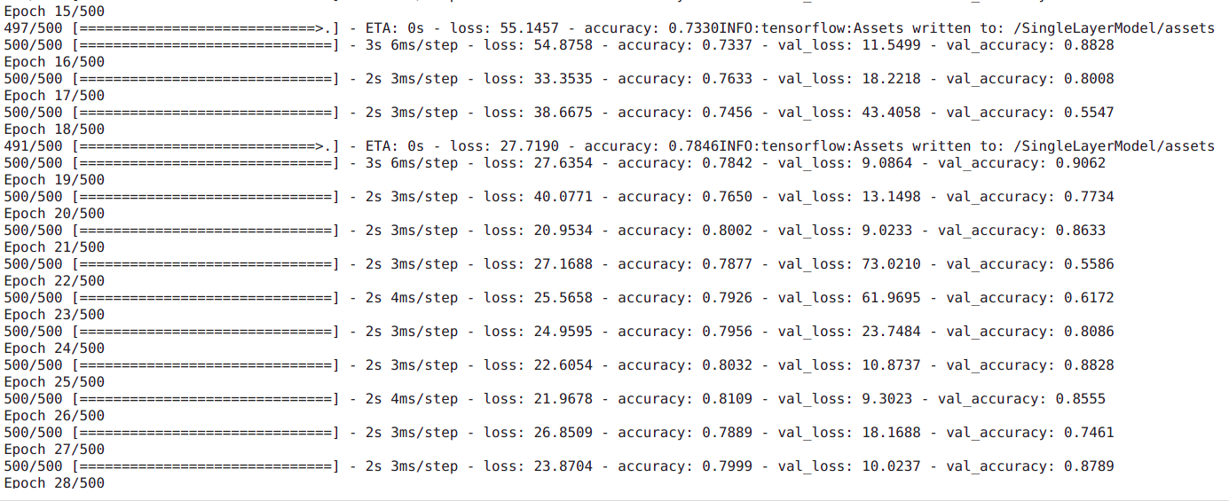
RESULTS
ONE HIDDEN LAYER
TWO HIDDEN LAYERS

Slide 13
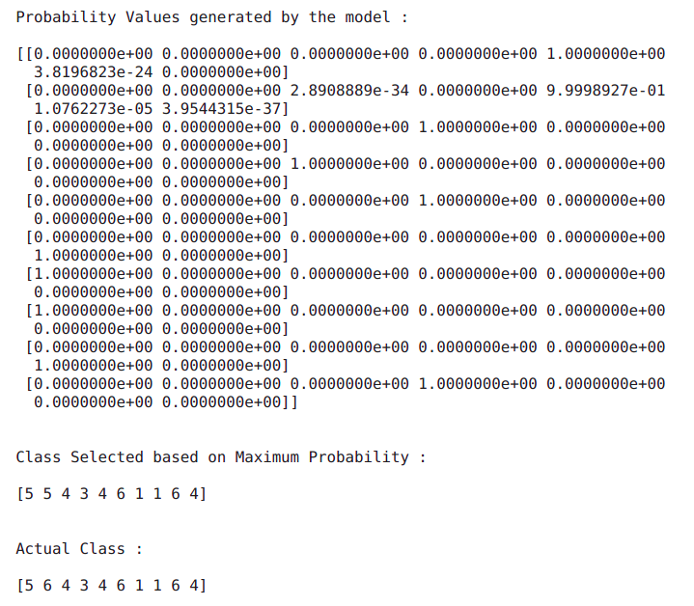
RESULTS - CONTD.

Slide 14
RESULTS - CONFUSION MATRICES (BALANCED)
PREDICTED CLASS
 | CLASS 1 | CLASS 2 | CLASS 3 | CLASS 4 | CLASS 5 | CLASS 6 | CLASS 7 | RECALL
CLASS 1 | 37143 | 28 | 451 | 130 | 639 | 90 | 680 | 94.85%
CLASS 2 | 0 | 3468 | 117 | 2 | 10 | 0 | 0 | 96.41%
CLASS 3 | 7 | 163 | 75187 | 88 | 73 | 94 | 60 | 99.36%
CLASS 4 | 298 | 22 | 5349 | 59827 | 549 | 8020 | 1 | 80.78%
CLASS 5 | 137 | 0 | 164 | 57 | 40428 | 6274 | 56 | 85.81%
CLASS 6 | 424 | 12 | 183 | 387 | 6416 | 77596 | 55 | 91.21%
CLASS 7 | 0 | 0 | 0 | 0 | 0 | 0 | 1143 | 100%
PRECISION | 97.72% | 93.91% | 91.63% | 98.90% | 84.02% | 84.28% | 57.32%
ACTUAL CLASS

Slide 15
RESULTS - F1 SCORES (BALANCED)
All classes except class 7 have an F1 score value of greater than 80% which is interpreted to be quite good
Macro average comes out to be 88.72% which again is interpreted as a quite accurate for an imbalanced multi-class classification
Class 7 is observed to have perfect recall but a poor precision. Similarly, classes 5 and 6 are observed to be poorly separable
To make further conclusions, it would be necessary to compare with recent research as these are relative values.
CLASS 1 | 96.26%
CLASS 2 | 95.14%
CLASS 3 | 95.34%
CLASS 4 | 88.93%
CLASS 5 | 84.91%
CLASS 6 | 87.61%
CLASS 7 | 72.87%
MACRO AVG | 88.72%

Slide 16
RESULTS - CONFUSION MATRICES (IMBALANCED)
PREDICTED CLASS
 | CLASS 1 | CLASS 2 | CLASS 3 | CLASS 4 | CLASS 5 | CLASS 6 | CLASS 7 | RECALL
CLASS 1 | 38639 | 30 | 79 | 328 | 8 | 24 | 53 | 98.67%
CLASS 2 | 27 | 3532 | 12 | 23 | 0 | 3 | 0 | 98.19%
CLASS 3 | 38 | 48 | 75246 | 218 | 87 | 33 | 2 | 99.44%
CLASS 4 | 486 | 132 | 124 | 72951 | 129 | 239 | 5 | 98.49%
CLASS 5 | 1482 | 4 | 85 | 355 | 42553 | 2486 | 150 | 90.32%
CLASS 6 | 241 | 0 | 107 | 281 | 3803 | 80539 | 102 | 94.67%
CLASS 7 | 235 | 2 | 18 | 4 | 5 | 25 | 854 | 74.72%
PRECISION | 93.90% | 94.24% | 99.44% | 98.37% | 91.34% | 96.63% | 73.24%
ACTUAL CLASS

Slide 17
RESULTS - F1 SCORES (IMBALANCED)
CLASS 1 | 96.23%
CLASS 2 | 96.17%
CLASS 3 | 99.44%
CLASS 4 | 98.43%
CLASS 5 | 90.83%
CLASS 6 | 95.64%
CLASS 7 | 73.97%
MACRO AVG | 92.96%
Imbalanced training was observed to given a better distribution between precision and recall as compared to balanced training
Particularly for class 7 with least number of samples, significant improvement in precision value by trading with recall (no free lunch)
F1-Score found to improve significantly for most of the classes
Conclusion: Imbalanced training gives better results as compared to balanced training

Slide 18
IMPROVEMENTS
More advanced methods can be explored for stacking fusion strategies - Variable feature selection, Bhattacharya’s distance based selection, etc.
More advanced and standard architectures for training the neural networks could offer improved accuracy
Study on how data was collected and how the radar and optical features were combined - Processes like coregistration and orthorectification

Slide 19
REFERENCES
Iman Khosravi & Seyed Kazem Alavipanah (2019) A random forest-based framework for crop mapping using temporal, spectral, textural and polarimetric observations, International Journal of Remote Sensing, 40:18, 7221-7251, DOI: 10.1080/01431161.2019.1601285
https://www.analyticsvidhya.com/blog/2021/04/getting-into-random-forest-algorithms/

